Slide 1



PyTorch
Aurimas Aleksandras Nausėdas

Slide 2

Agenda
PyTorch
Introduction
PyTorch Basics
Train A Simple Neural Net
PyTorch in Action
Data Loading, Loss & Optimizers
Visualisation
Save & Load
8. Conclusion
1

Slide 3
Terms
PyTorch
PyTorch
Tensor
FloatTensor
Autograd
Variable
Compuational Graph
Torch.nn
Torch.nn.functional
GPU
GRU
Dataloader
Batch size
Iterations
Epoch
Loss Function
Optimizer
Visdom
TensorBoard
2

Slide 4
Introduction

Slide 5
What is PyTorch?
PyTorch
It’s a Python-based scientific computing package targeted at two sets of audiences¹
A replacement for NumPy to use the power of GPUs
A deep learning research platform that provides maximum flexibility and speed
1 - https://pytorch.org/tutorials/beginner/blitz/tensor_tutorial.html
3

Slide 6
What is PyTorch?
PyTorch
CPU
Complicate & sequential processing
GPU
Simple but fast & parallel computing
We would like to use GPU to accelerate the training of our neural nets
4

Slide 7
What is PyTorch?
PyTorch
Data
Abundant NumPy arrays
Your code
Training procedure
GPU-accelerated libraries
Parallel, fast training
GPU
However, CUDA is a low-level language and not available on all machines..
5

Slide 8
What is PyTorch?
PyTorch
Deep learning framework
Data
Abundant NumPy arrays
Your code
Training procedure
GPU-accelerated libraries
Parallel, fast training
GPU
6
Notes:
(1) Quick to develop and test new ideas
(2) Run it all efficiently on GPU
(3) Automatically compute gradients

Slide 9
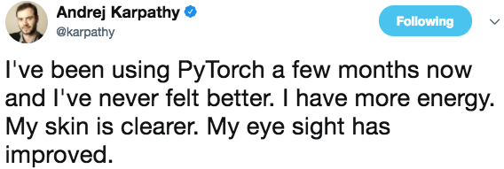

Why PyTorch?
PyTorch
Life is short, you need
7
Notes:
"PyThonic" - easy to use
Strong GPU support - models run fast Many algorithms are already implemented
Automatic diferentiation - more in next lesson
Similar to NumPy
Support Python
Dynamic Graph
Friendly API for research
Easily debug
Love all things [Pythonic]

Slide 10
Why PyTorch?
PyTorch
It is pythonic - concise, close to Python conventions
Strong GPU support
Autograd - automatic differentiation
Many algorithms and components are already implemented
Similar to NumPy
8
Notes:
"PyThonic" - easy to use
Strong GPU support - models run fast Many algorithms are already implemented
Automatic diferentiation - more in next lesson
Similar to NumPy
Support Python
Dynamic Graph
Friendly API for research
Easily debug
Love all things [Pythonic]

Slide 11
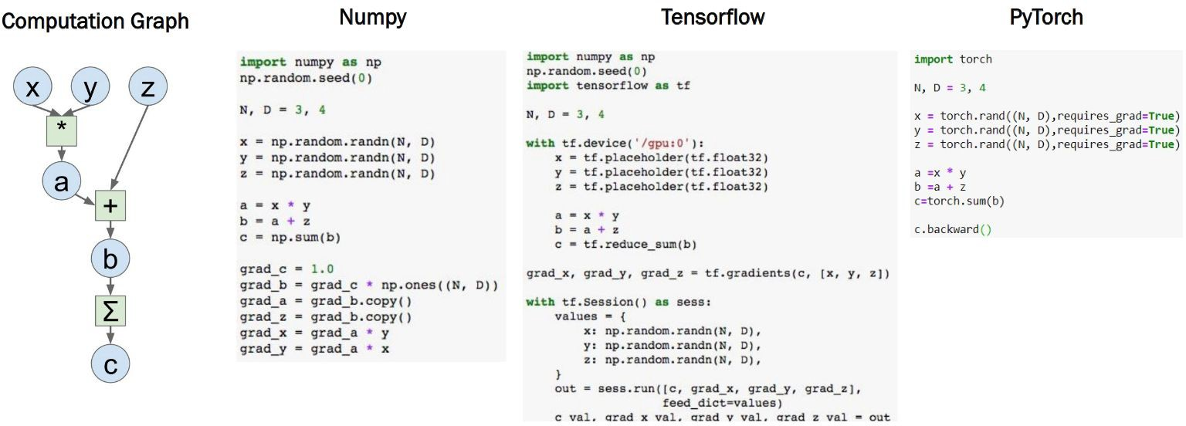
Why PyTorch?
PyTorch
9

Slide 12
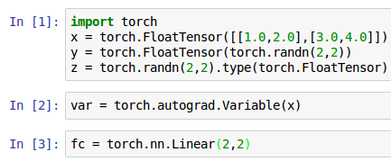
Three Levels of Abstraction
PyTorch
Tensor: Imperative ndarray
Variable: Node in a computational graph (data, grad)
Module: A neural network layer
10
Notes:
Imperative ndarray but runs on gpu
Node in a computational graph; stores data and gradient
A neural entwork layer; may store stable state or learnable weights

Slide 13
Major Components of PyTorch
PyTorch
Package | Description
torch | a Tensor library like NumPy, with strong GPU support
torch.autograd | a tape based automatic differentiation library that supports all differentiable Tensor operations in torch
torch.nn | a neural networks library deeply integrated with autograd designed for maximum flexibility
torch.optim | an optimization package to be used with torch.nn with standard optimization methods such as SGD, RMSProp, LBFGS, Adam etc.
torch.utils | DataLoader, Dataset and other utility functions for convenience
11

Slide 14
PyTorch Basics

Slide 15
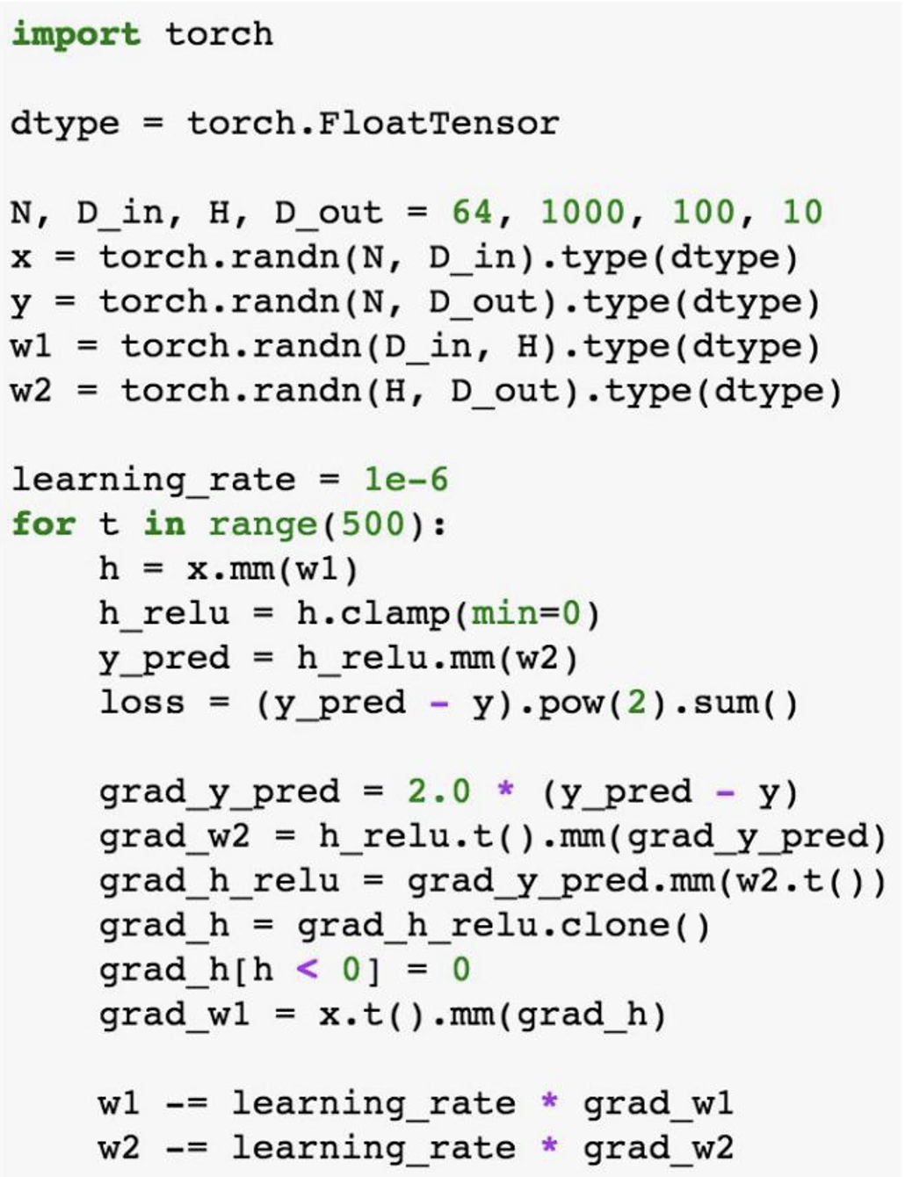
PyTorch Tensors
PyTorch
Like numpy arrays, but they can run on GPU.
No built-in notion of computatiomnal graph,
or gradients, or deep learning.
Here you see a fit of a two-layer net using
PyTorch Tensors.²
The biggest difference between a numpy array
and a PyTorch Tensor is that a PyTorch Tensor
can run on either CPU or GPU.²
2 - Stanford cs231n & https://pytorch.org/tutorials/beginner/examples_tensor/two_layer_net_tensor.html
12

Slide 16
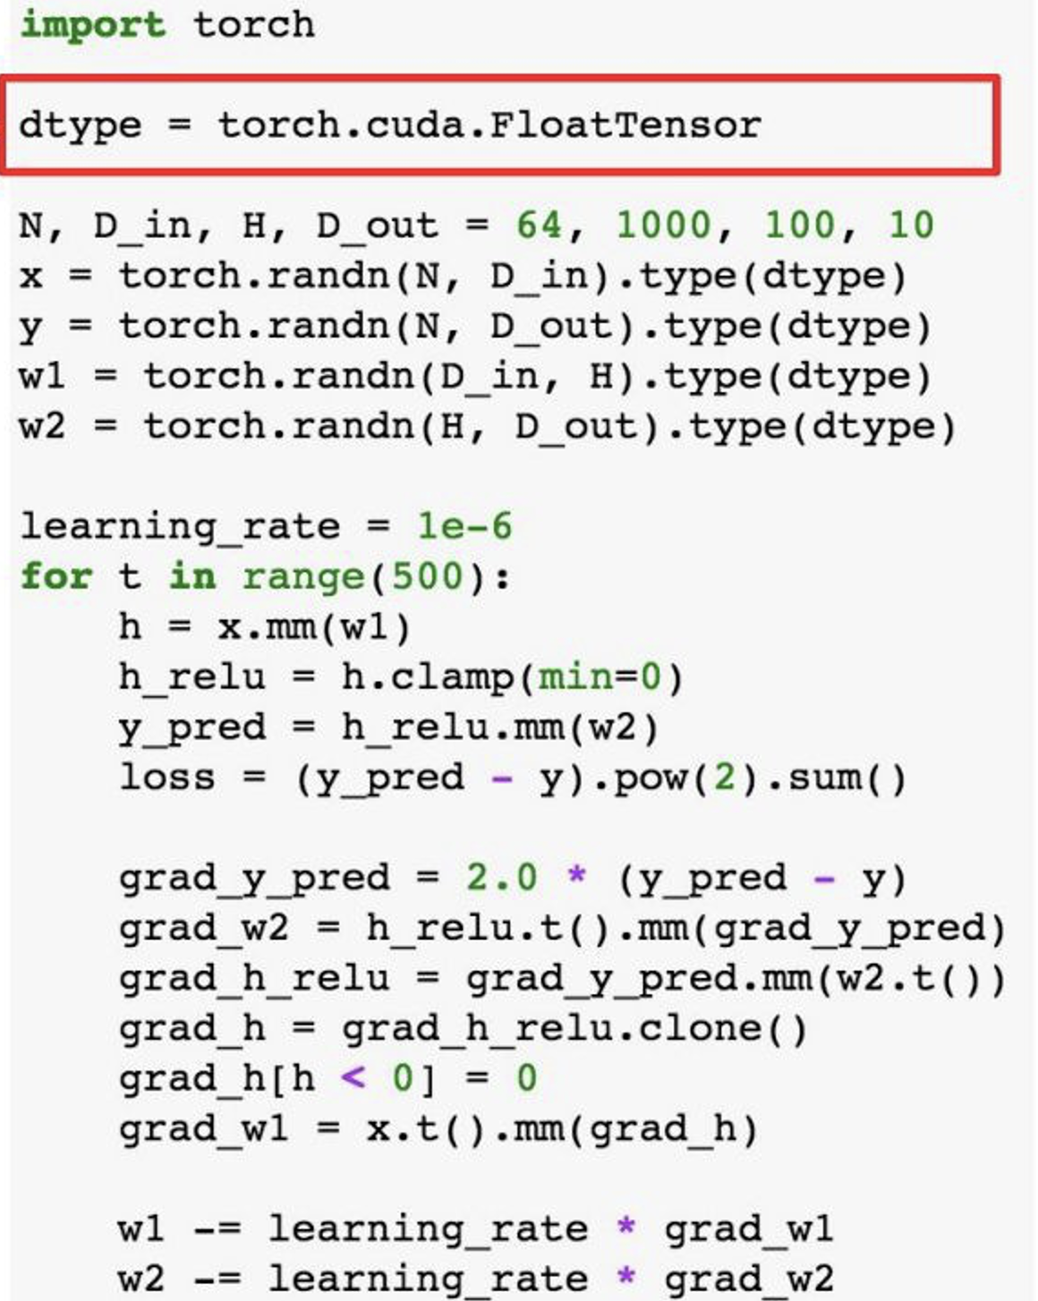
PyTorch Tensors
PyTorch
To run on GPU just cast tensors to CUDA type
13
Stanford cs231n

Slide 17
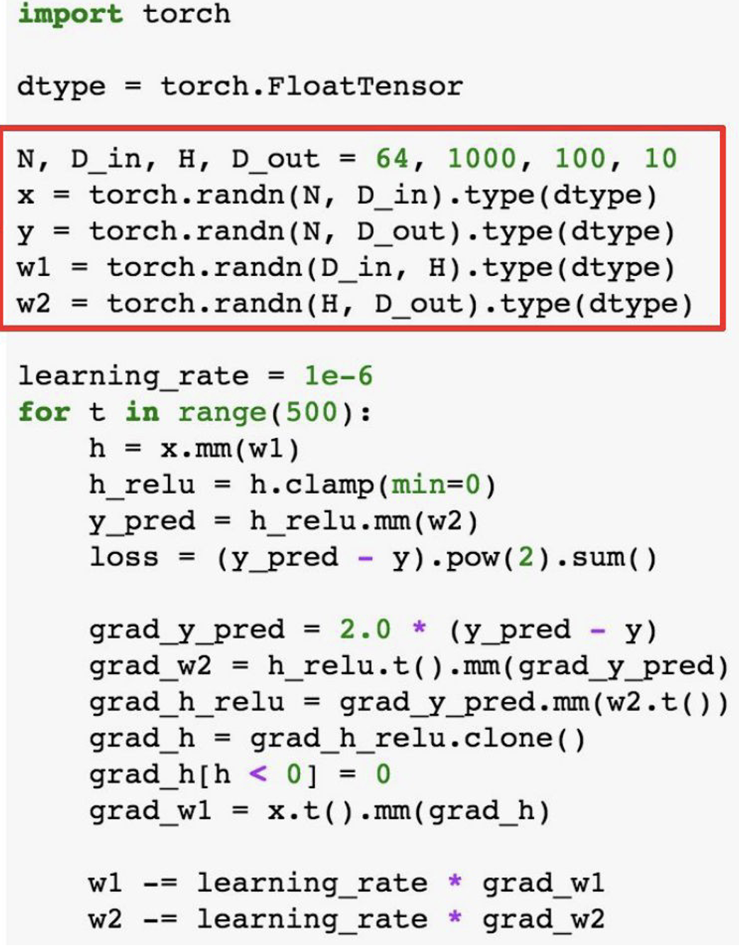
PyTorch Tensors
PyTorch
Create random tensors for data and weights
14
Stanford cs231n

Slide 18
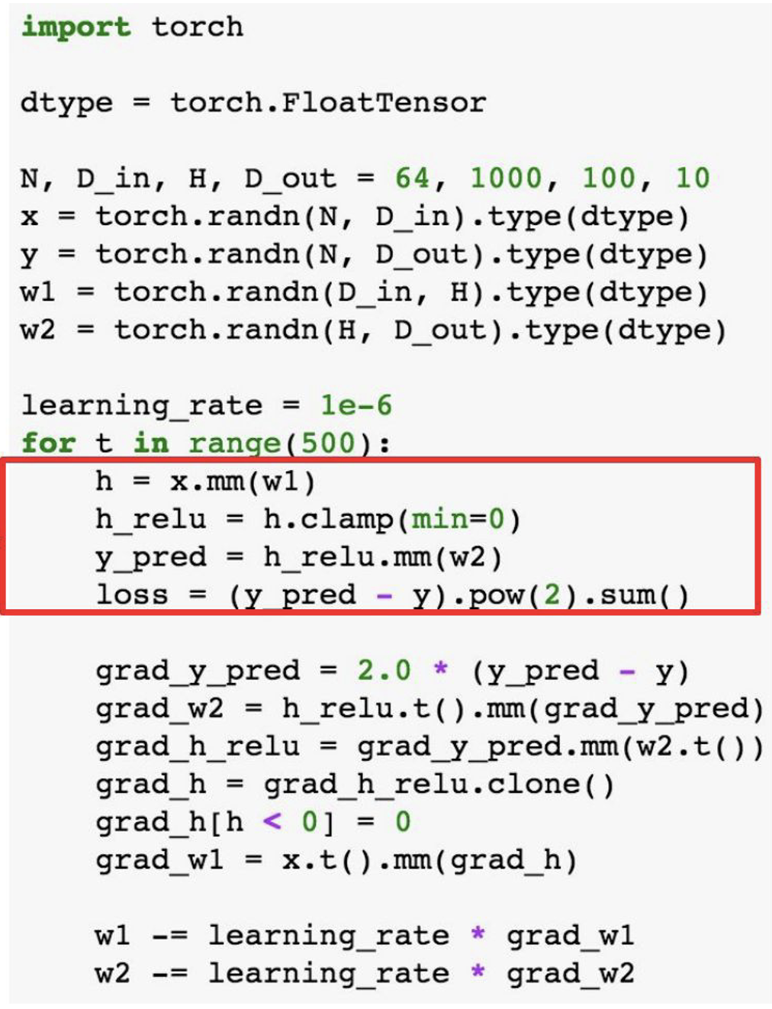
PyTorch Tensors
PyTorch
Forward prop: compute predictions and loss
15
Stanford cs231n

Slide 19
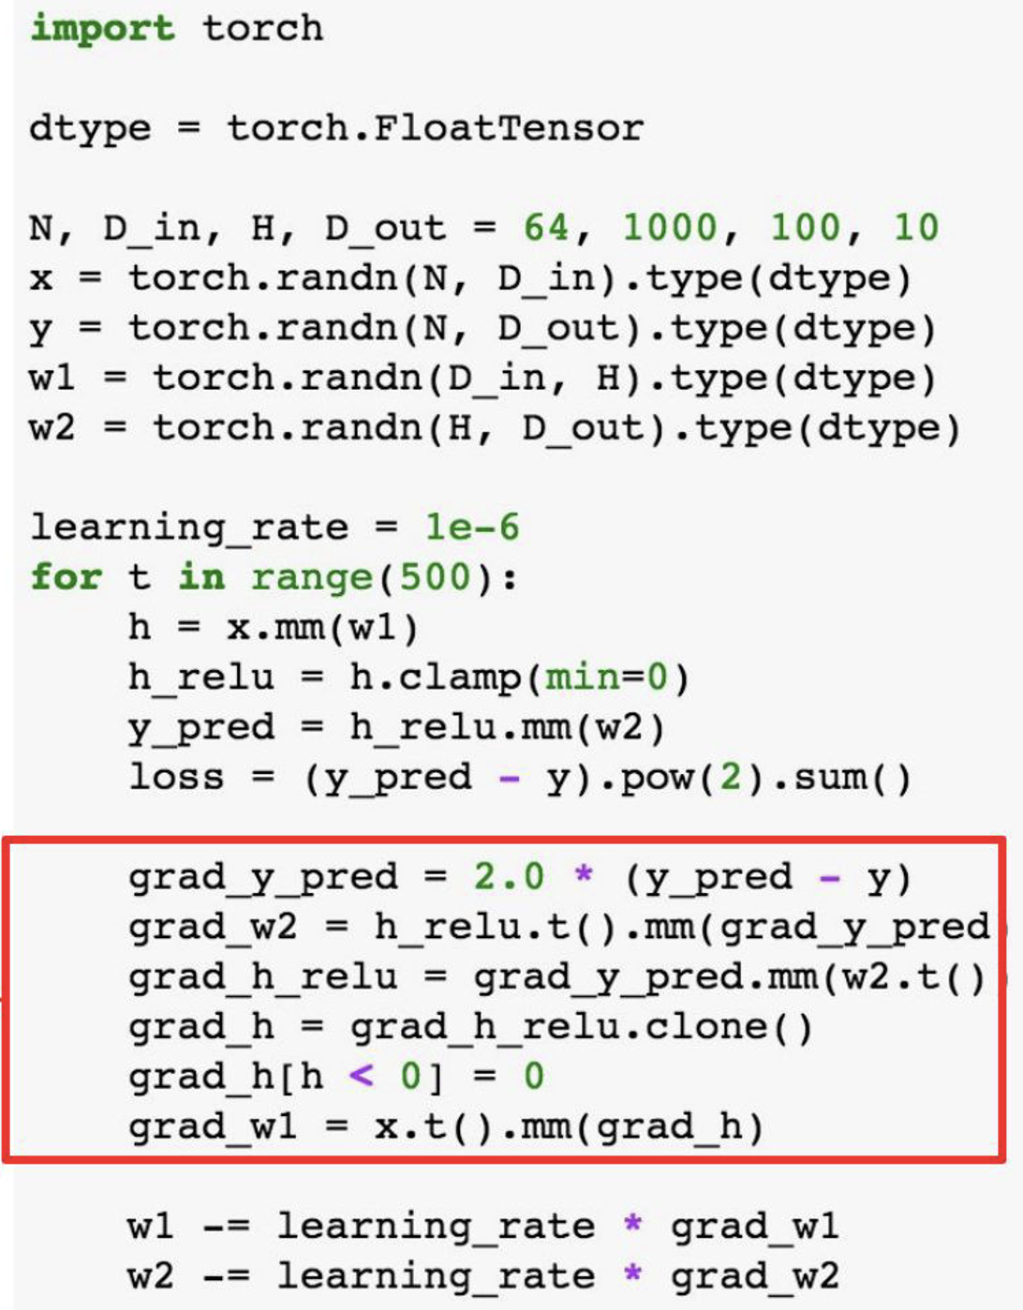
PyTorch Tensors
PyTorch
Backward prop:
Manually compute
gradients
16
Stanford cs231n

Slide 20
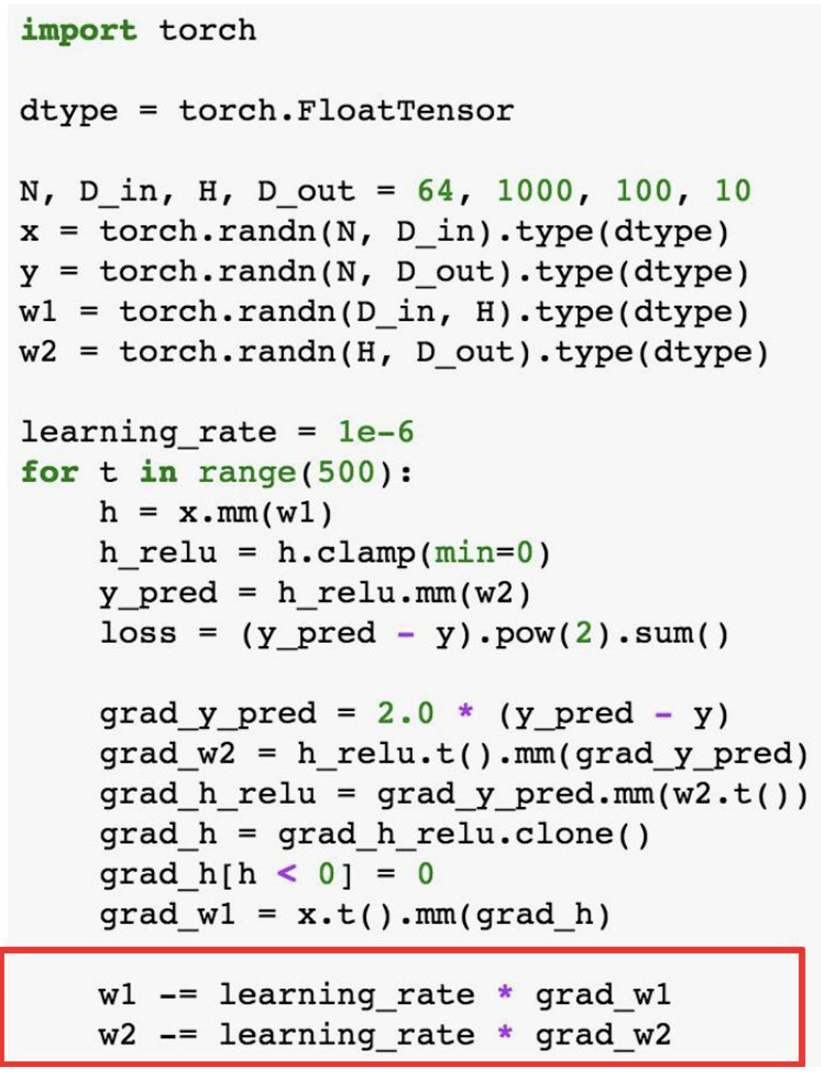
PyTorch Tensors
PyTorch
Gradient descent
step on weights
17
Stanford cs231n

Slide 21
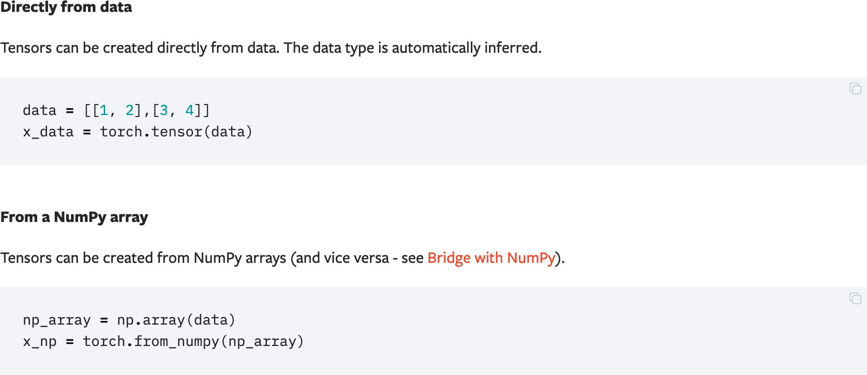
Initializing a Tensor
PyTorch
18

Slide 22
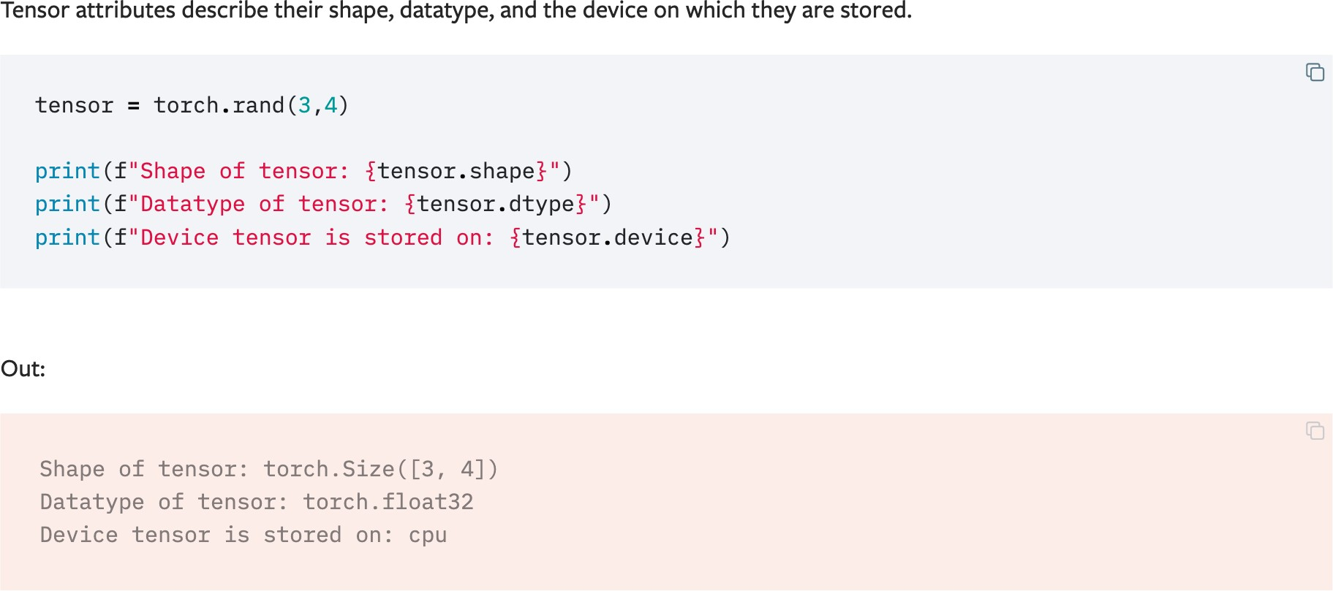
Attributes of a Tensor
PyTorch
19

Slide 23
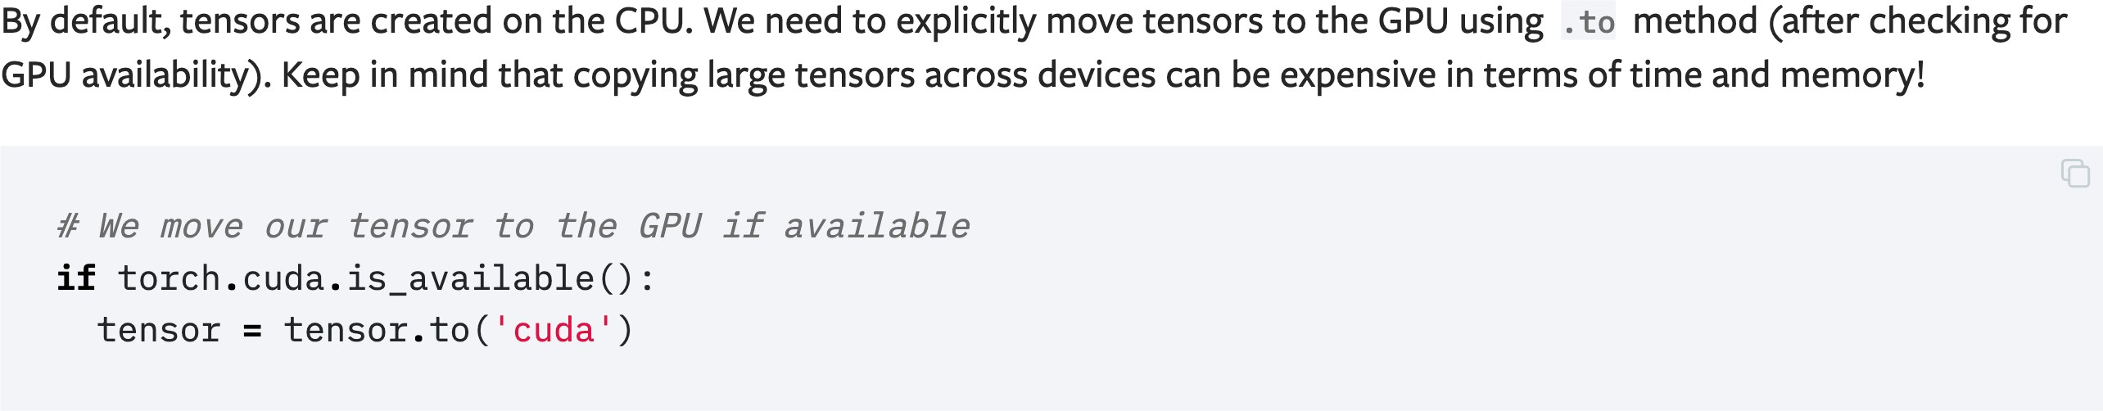
Operations on Tensors
PyTorch
20

Slide 24
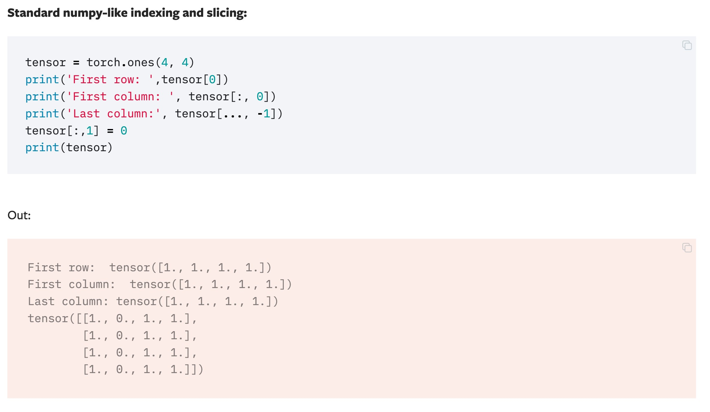
Operations on Tensors
PyTorch
21

Slide 25
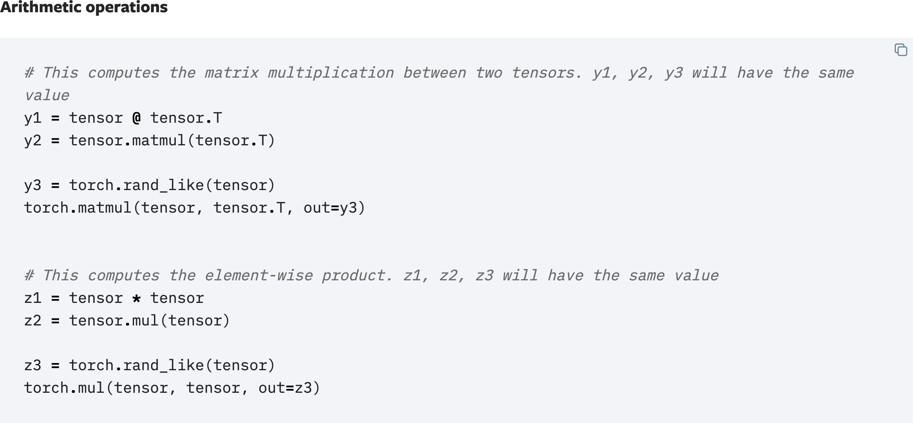
Operations on Tensors
PyTorch
22

Slide 26
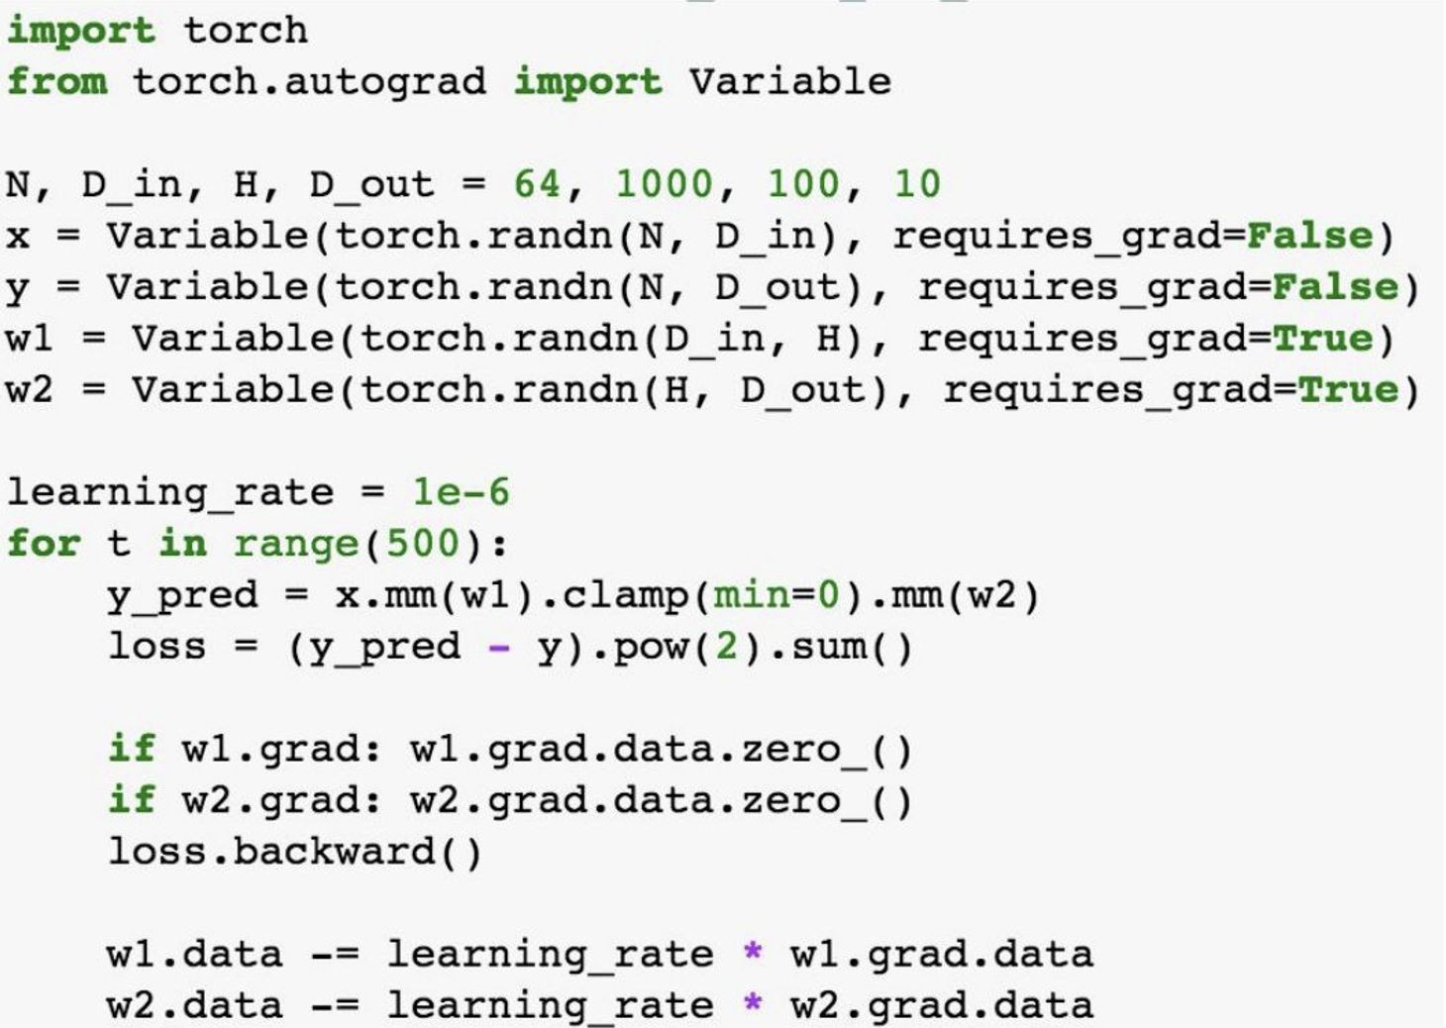
PyTorch: Autograd
PyTorch
A PyTorch Variable is a node in a
computational graph
x.Data is a Tensor
x.Grad is a Variable of gradients
(same shape as x.data)
x.grad.data is a Tensor of gradients
23
Stanford cs231n

Slide 27
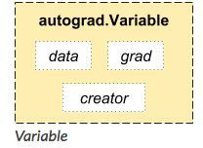
Variable
PyTorch
The autograd package provides automatic differentiation for all operations on Tensors.
“autograd. Variable is the central class of the package. It wraps a Tensor, and supports nearly all of operations defined on it.
Once you finish your computation you can call .backward() and have all the gradients computed automatically. “
24
Pytorch Tutorial. www.pytorch.org

Slide 28
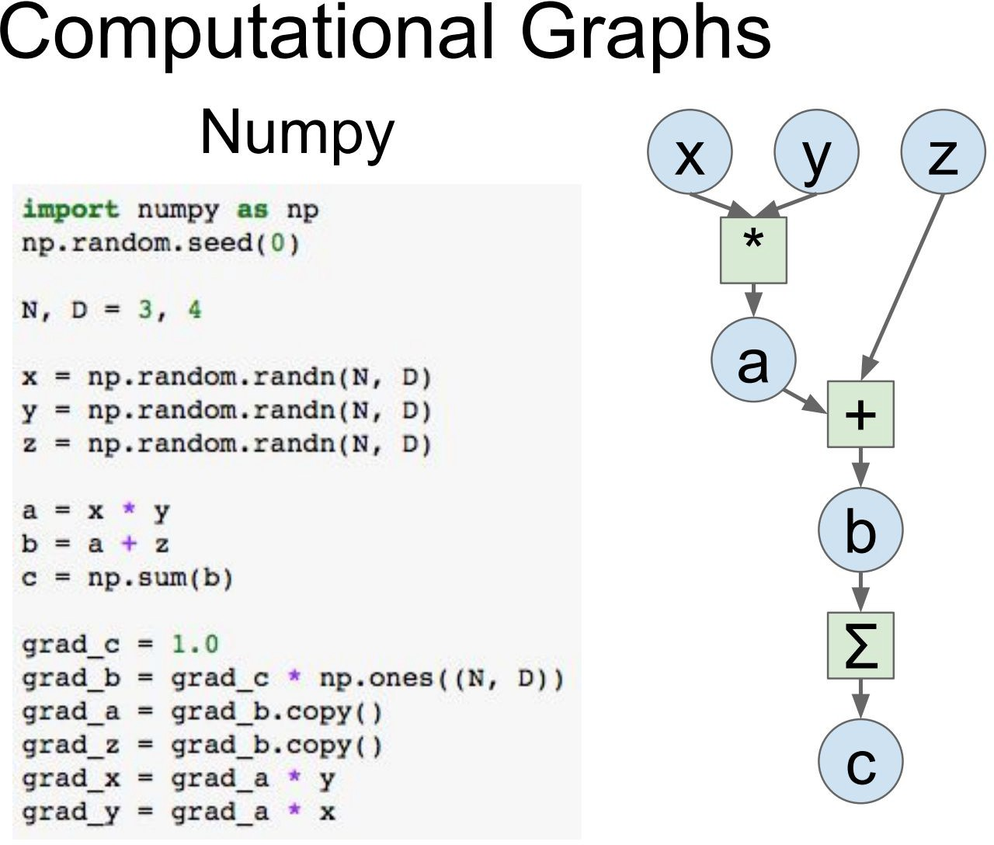
Computational Graphs
PyTorch
25

Slide 29
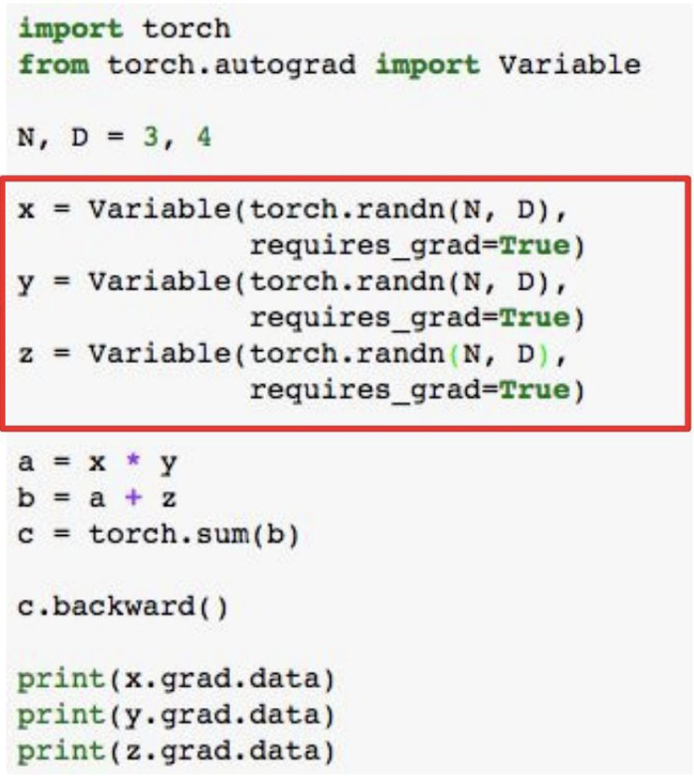
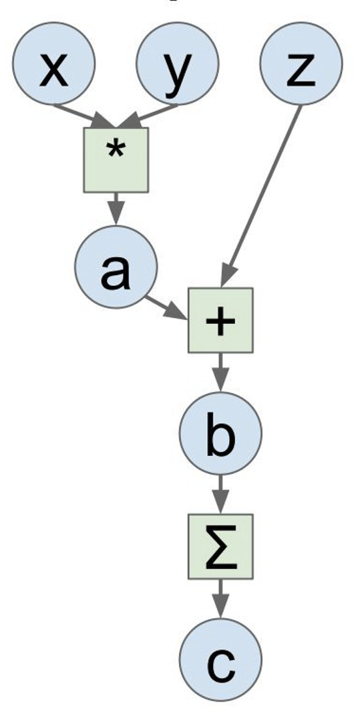
Computational Graphs
PyTorch
Define Variables to
start building a
computational graph
26

Slide 30
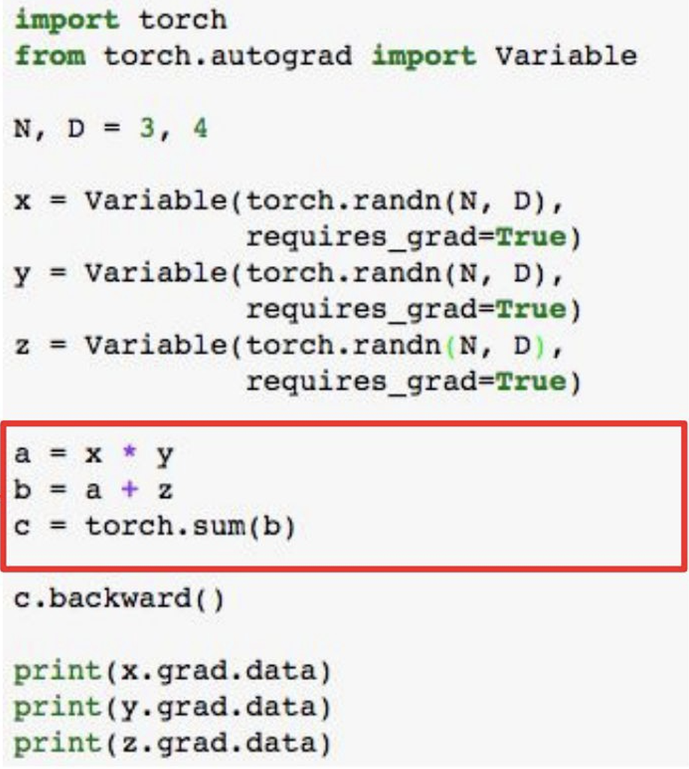
Computational Graphs
PyTorch
Forward prop
looksjust like
numpy
27

Slide 31
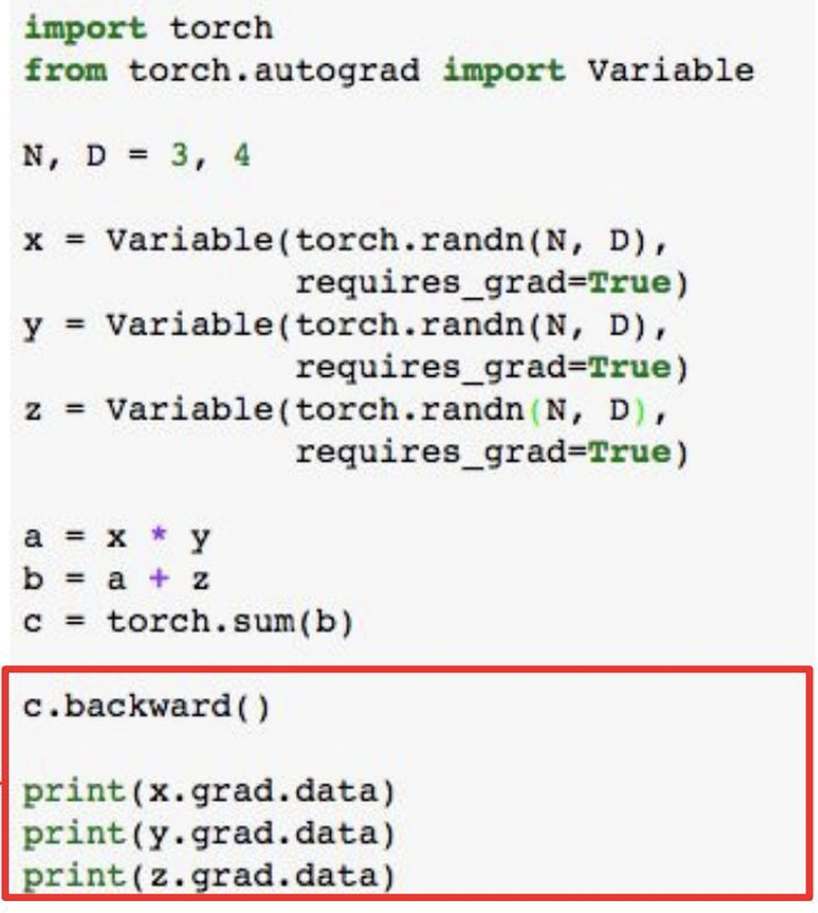
Computational Graphs
PyTorch
Calling c.backward()
computes all
gradients
28

Slide 32
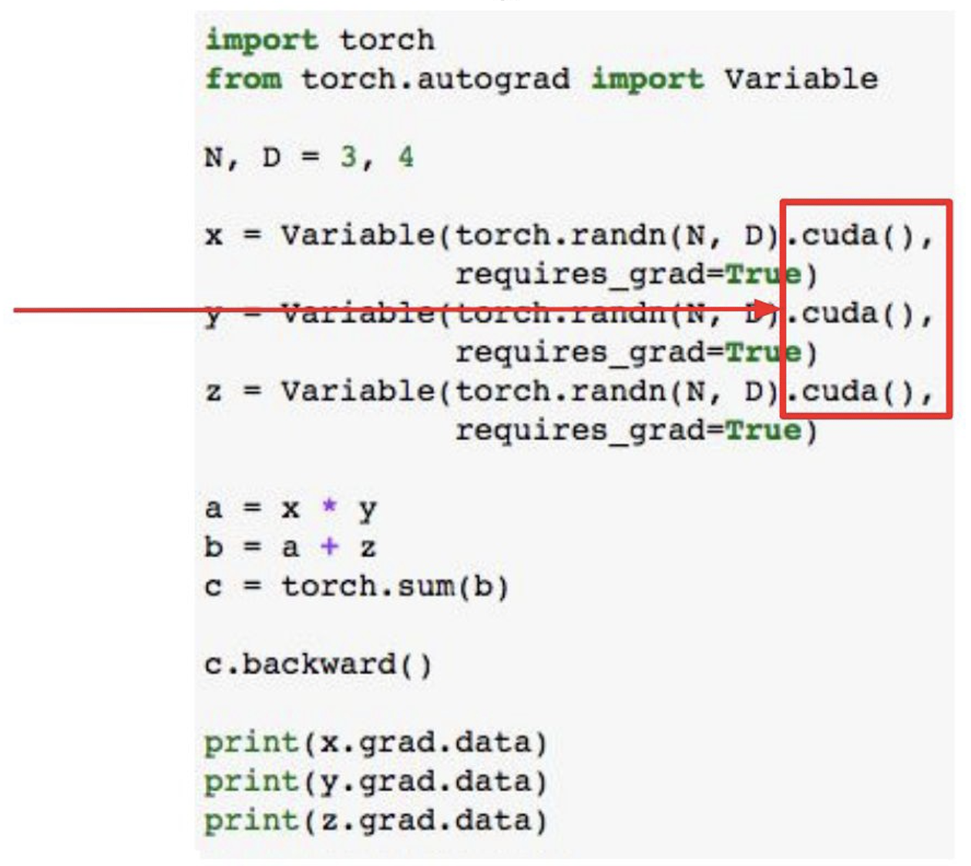
Computational Graphs
PyTorch
Run on GPU by
calling .cuda()
29

Slide 33
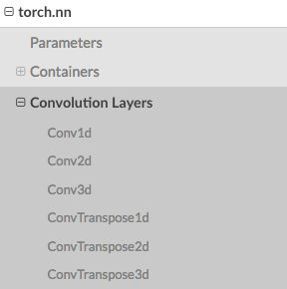
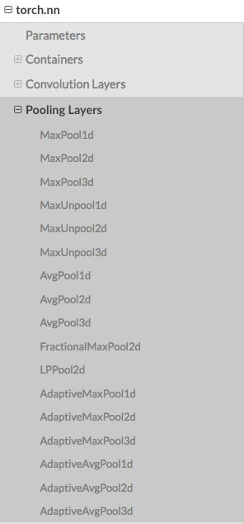
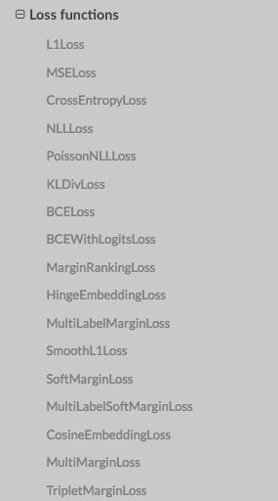
Module
PyTorch
Other layers:
Dropout, Linear,
Normalization Layer
30

Slide 34
Module – torch.nn
PyTorch
Containers | Module, Sequential,ModuleList,ParameterList
Convolution Layers | Conv1d,Conv2d,Conv3d…
Recurrent Layers | RNN,LSTM,GRU,RNNCell…
Linear Layers | Linear, Bilinear
Non-linear Activations | ReLU,Sigmoid,Tanh,LeakyReLU…
Loss Functions | NLLLoss,BCELoss,CrossEntropyLoss…
31

Slide 35
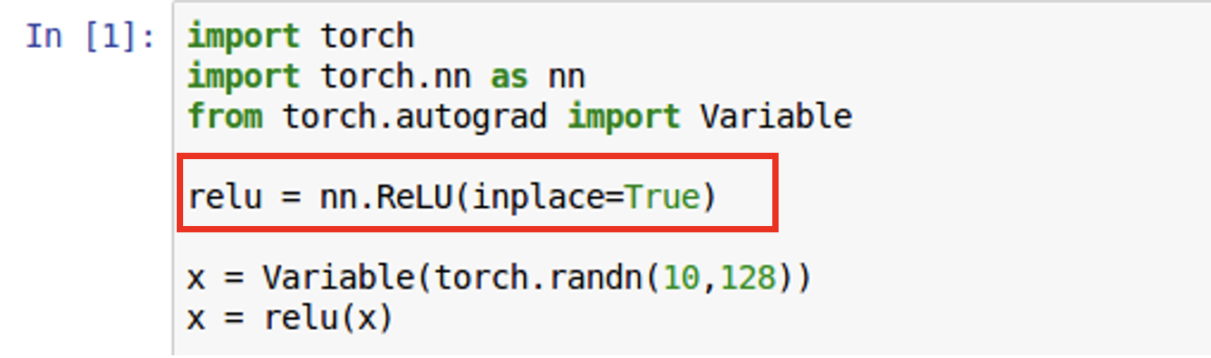
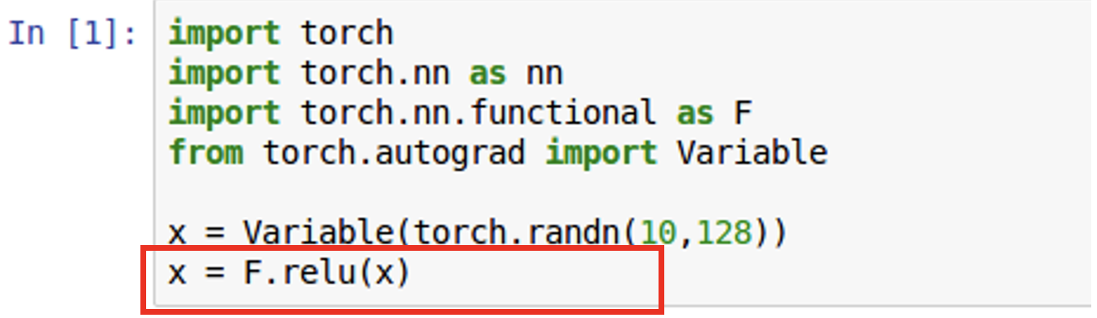
Module – torch.nn.funtional
PyTorch
Torch.nn
Torch.nn.functional
32

Slide 36
Train a Simple Neural Net

Slide 37
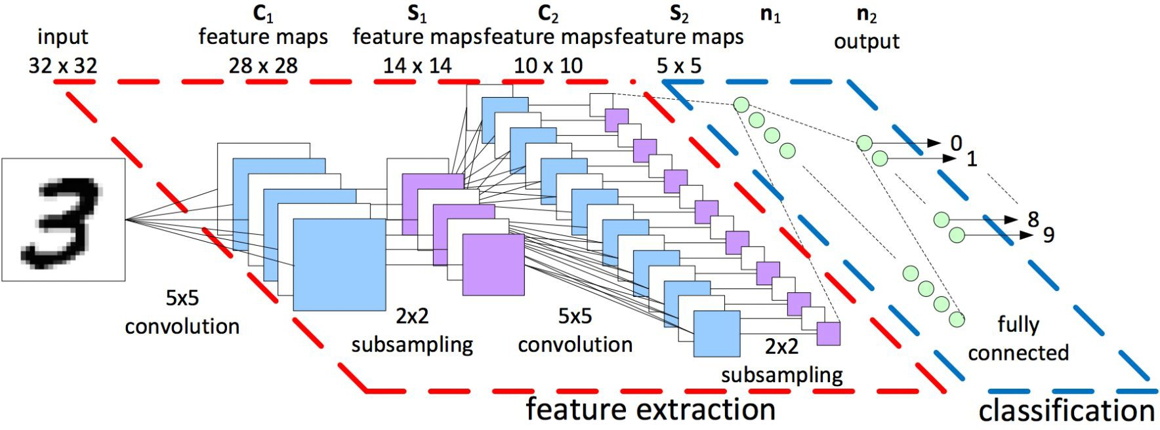
Train a simple Neural Net
PyTorch
Forward: compute output of each layer
Backward: compute gradient
Update: update the parameters with computed gradient
33

Slide 38
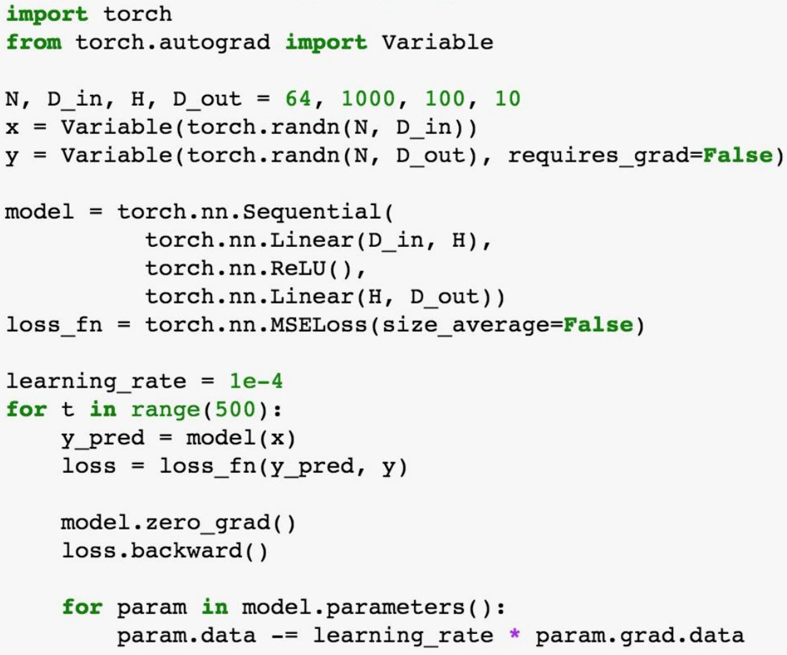
PyTorch: nn
PyTorch
Higher-level wrapper for
working with Neural nets
Simialr to Keras and friends …
But only one and it’s good
34

Slide 39
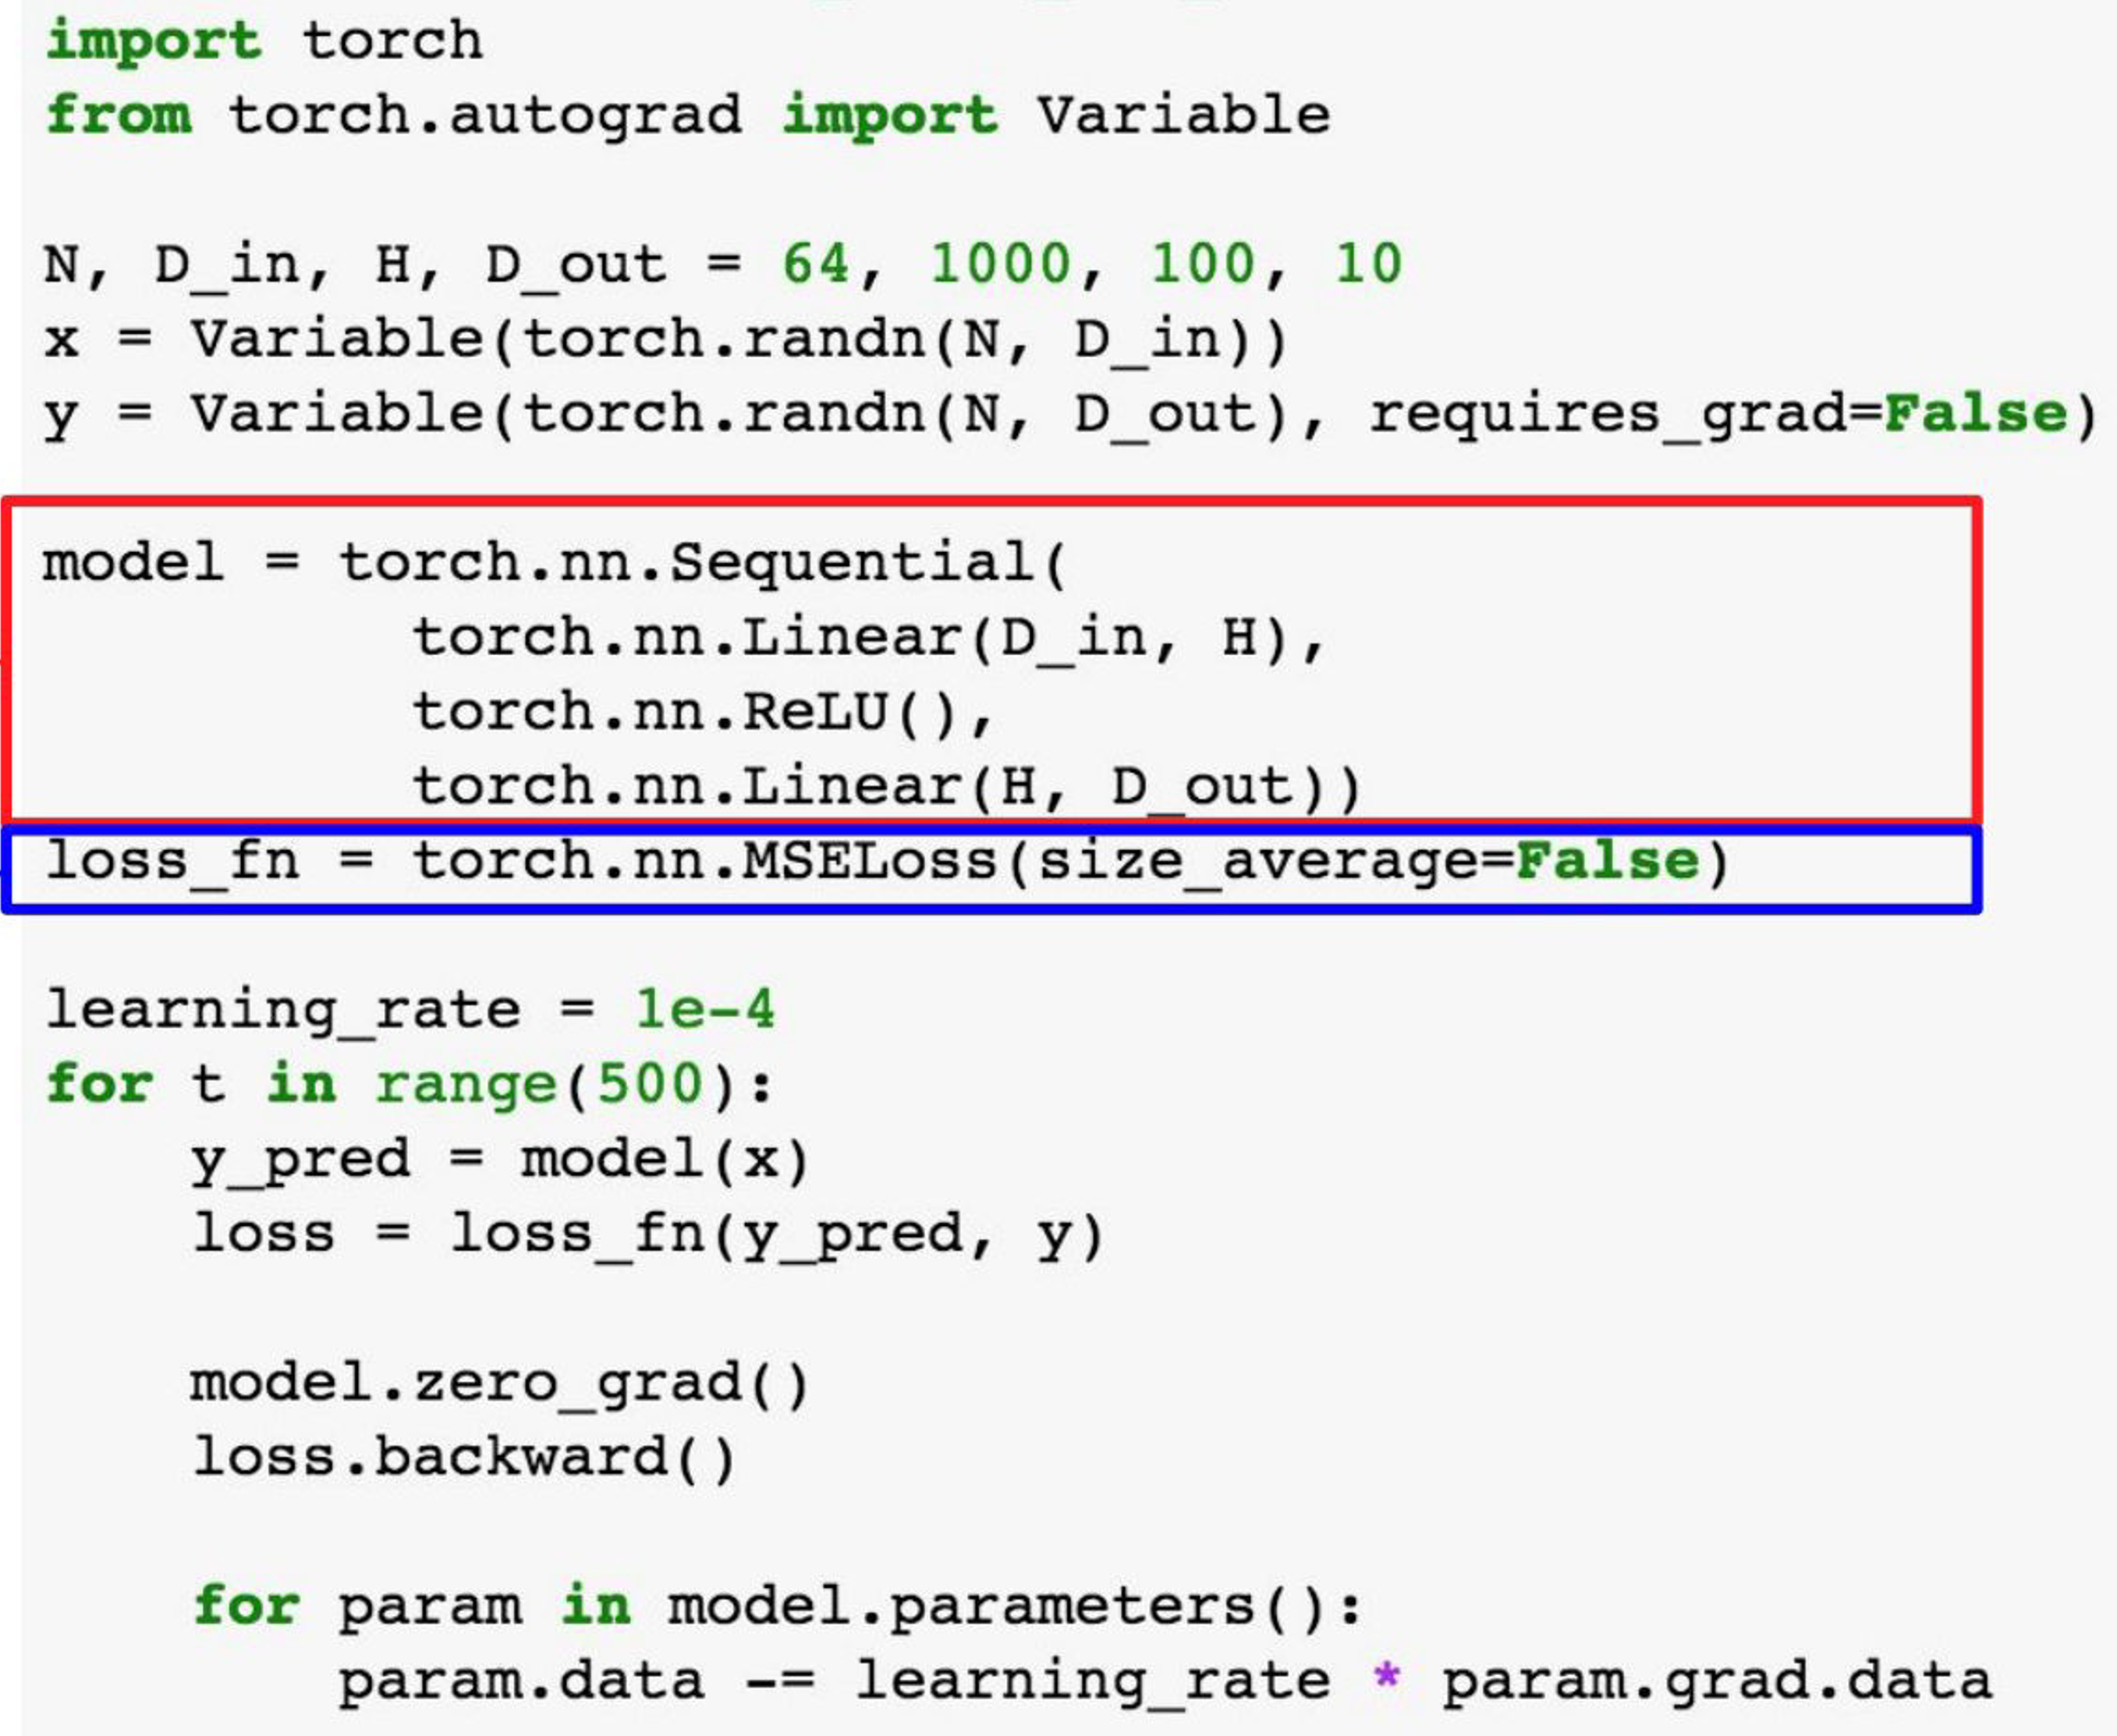
PyTorch: nn
PyTorch
Define our model as a
sequence of layers
nn also define common
loss functions
35

Slide 40
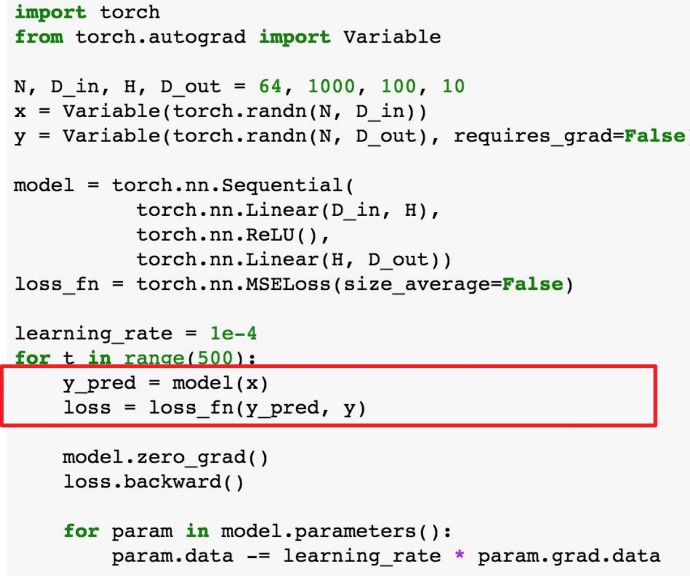
PyTorch: nn
PyTorch
Forward prop: feed data
to model, and prediction
to loss function
36

Slide 41
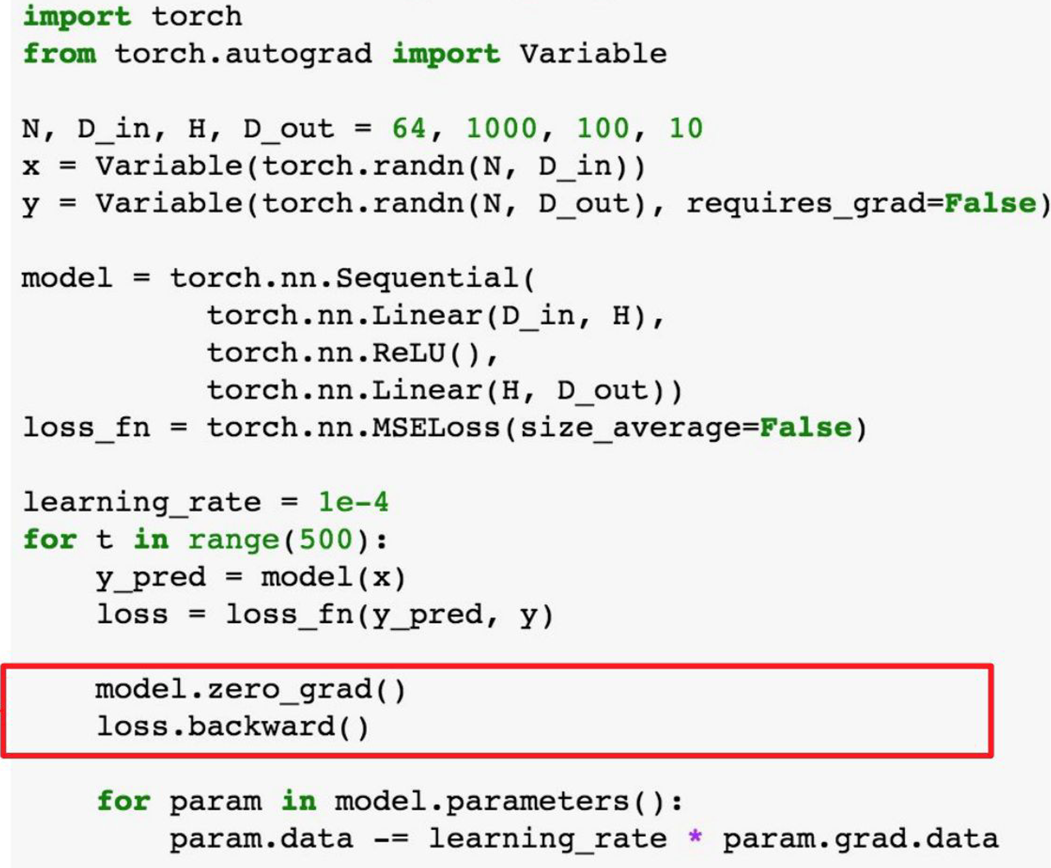
PyTorch: nn
PyTorch
Backward prop:
compute all gradients
37

Slide 42
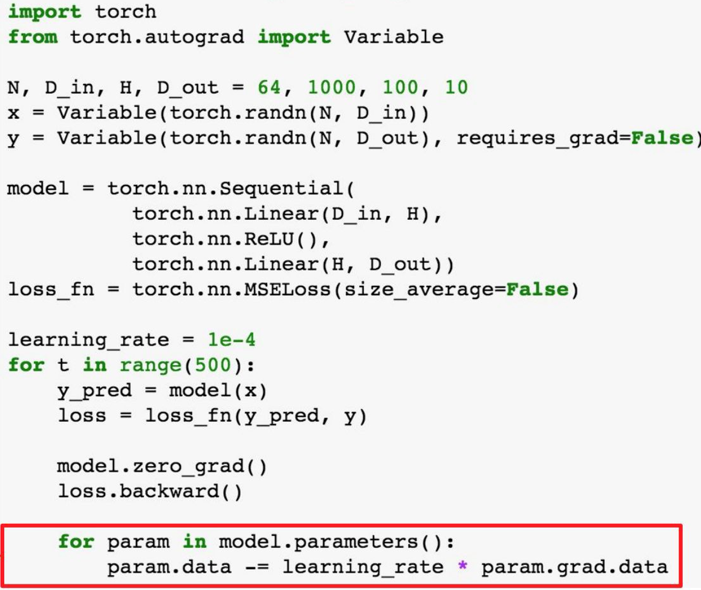
PyTorch: nn
PyTorch
Make gradient step on
each model parameter
38

Slide 43
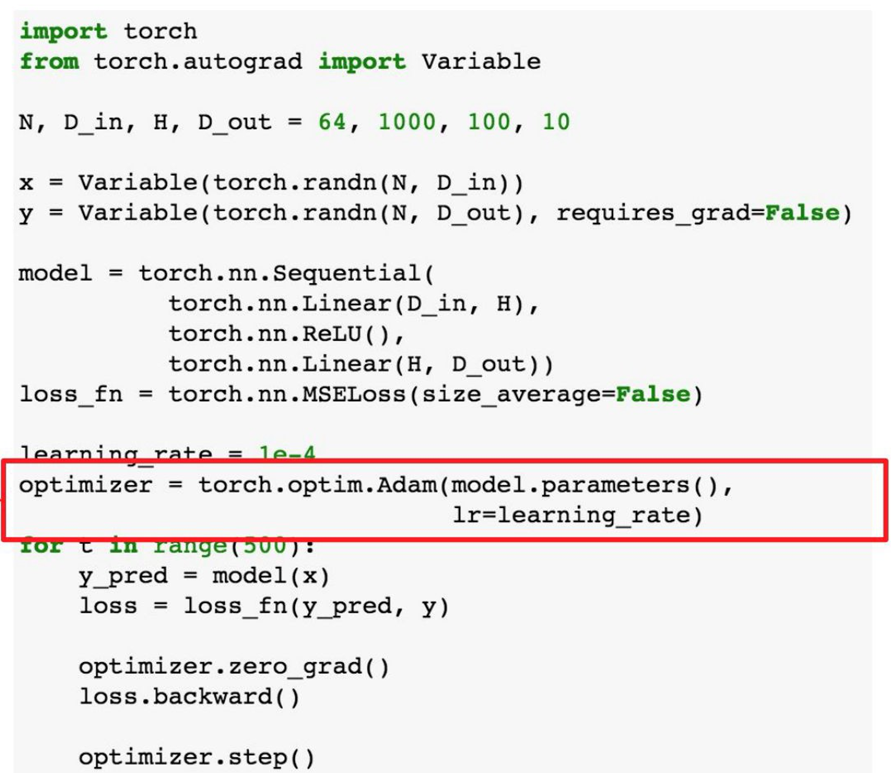
PyTorch: optim
PyTorch
Use an optimzer for
different rules
39

Slide 44
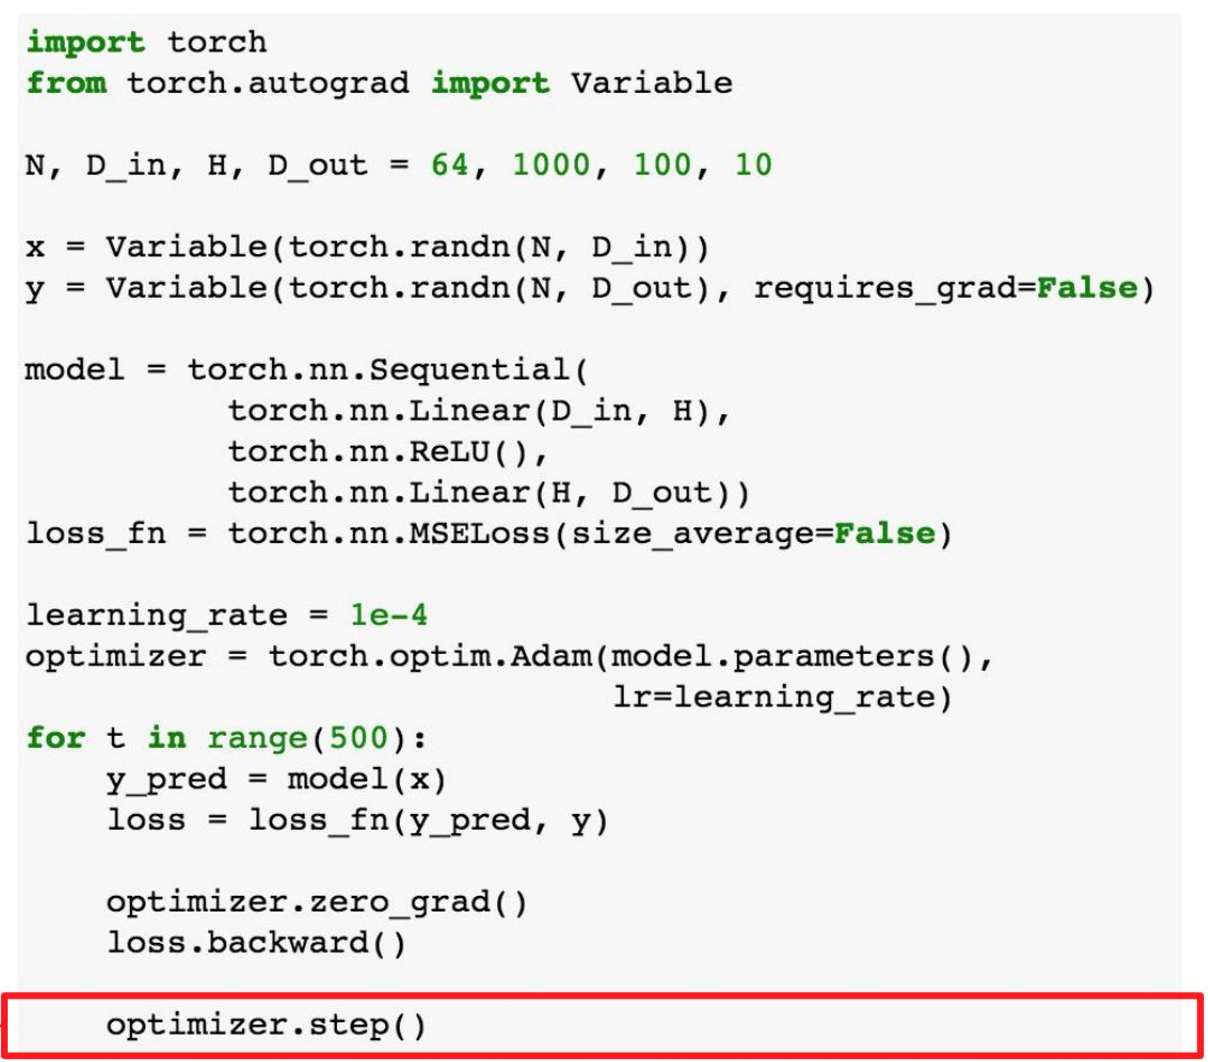
PyTorch: optim
PyTorch
Update all parameters
after computing gradients
40

Slide 45
PyTorch in Action

Slide 46
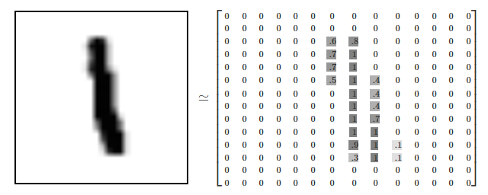
MNIST Dataset
PyTorch
41

Slide 47
MNIST Example
PyTorch
42

Slide 48
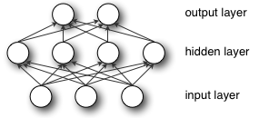
MLP for MNIST (0-d features)
PyTorch
10
64
28*28
43

Slide 49
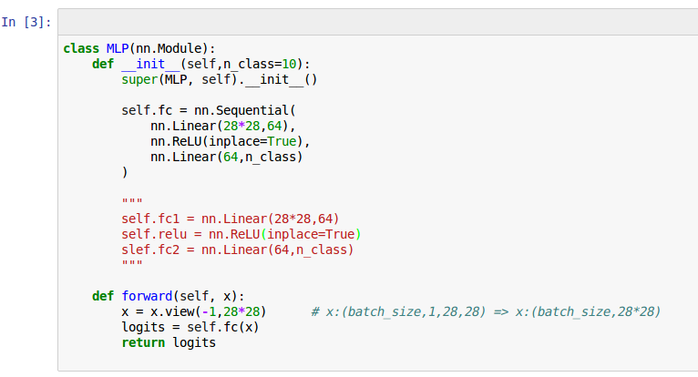
MLP for MNIST
PyTorch
Last Test Acc: 95.8%
44

Slide 50
RNN for MNIST (1-d features)
PyTorch
GRU
GRU
…
GRU
28
…
28
45

Slide 51
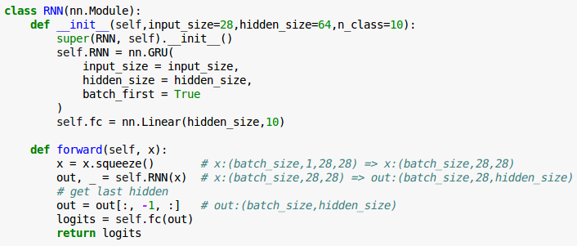
RNN for MNIST
PyTorch
Last Test Acc: 97.7%
46

Slide 52
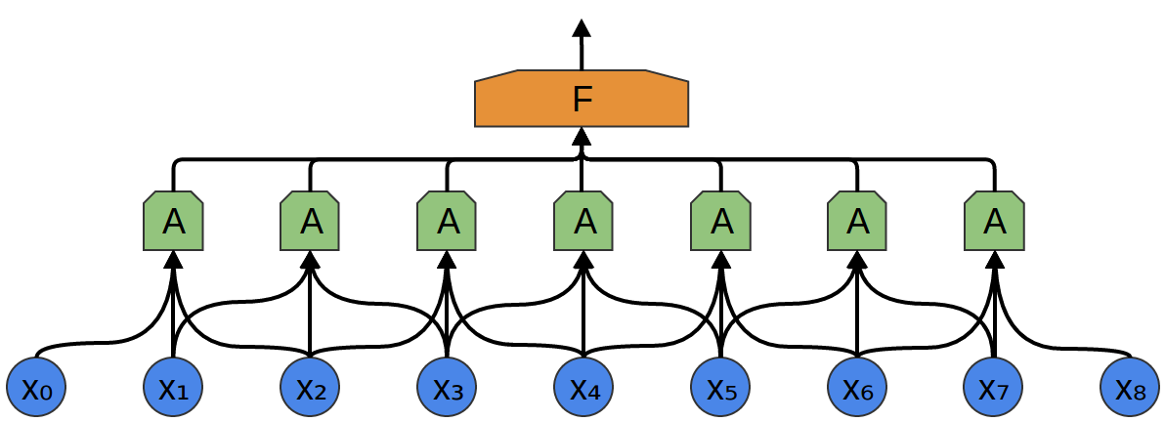

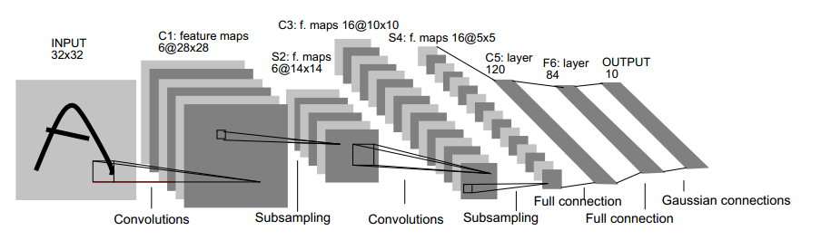
CNN for MNIST (2-d features)
PyTorch
47

Slide 53
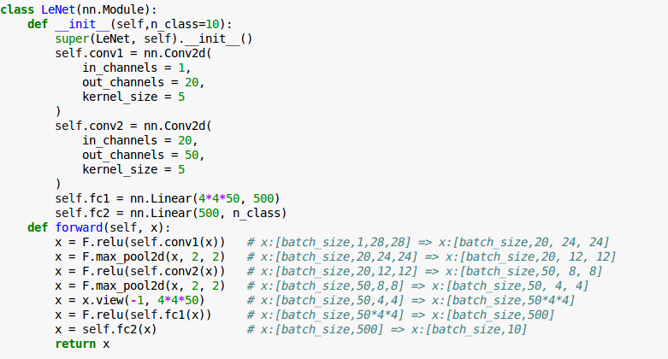
CNN for MNIST
PyTorch
Last Test Acc: 99.2%
48

Slide 54
Data Loading, Loss & Optimizers

Slide 55
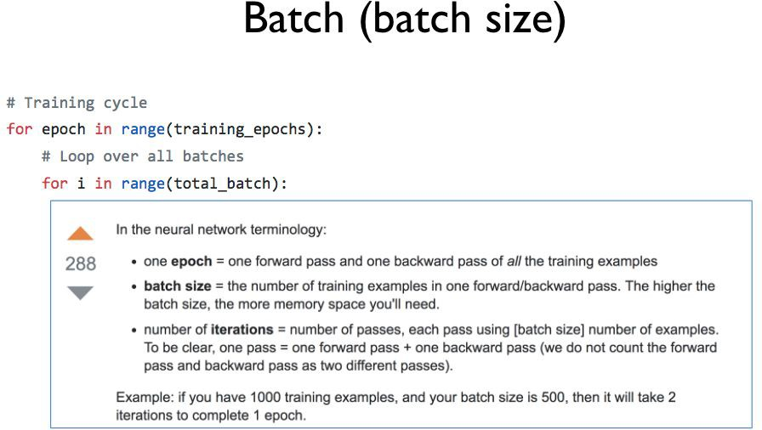
Data Loading
PyTorch
49
Pytorch, zero to all. HKUST

Slide 56
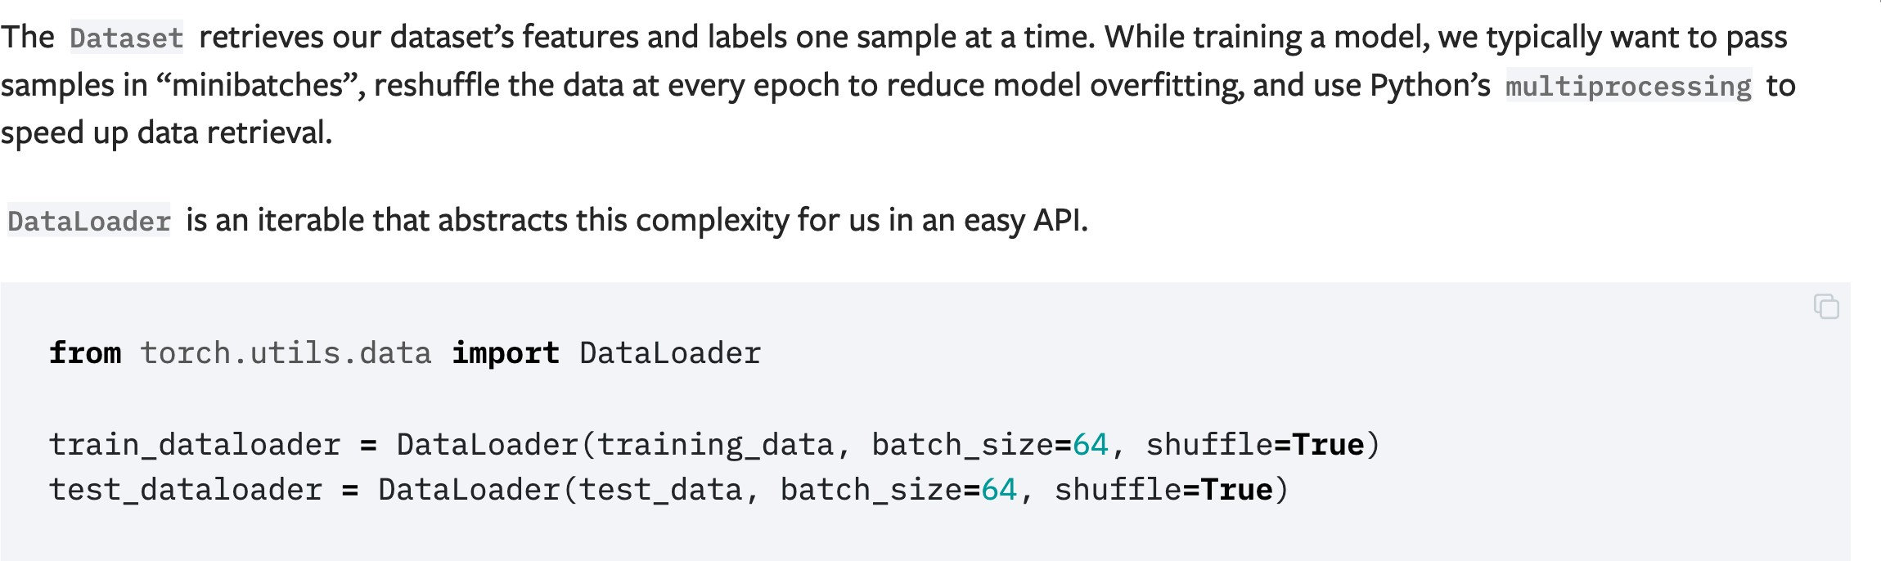
Dataloader
PyTorch
50

Slide 57
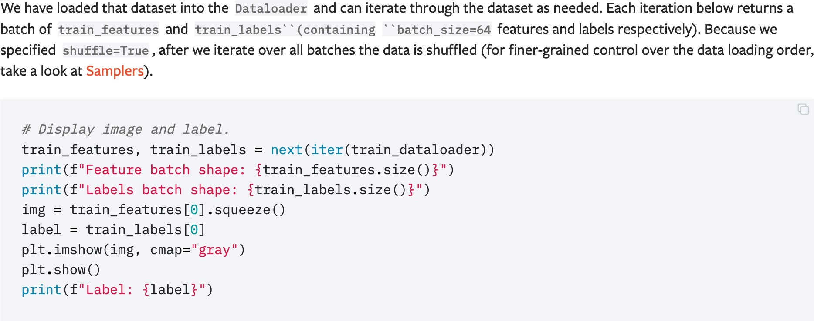
Iterate through Dataloader
PyTorch
51

Slide 58
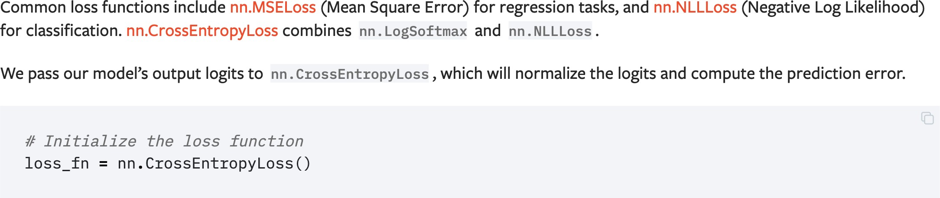
Loss Function
PyTorch
52

Slide 59
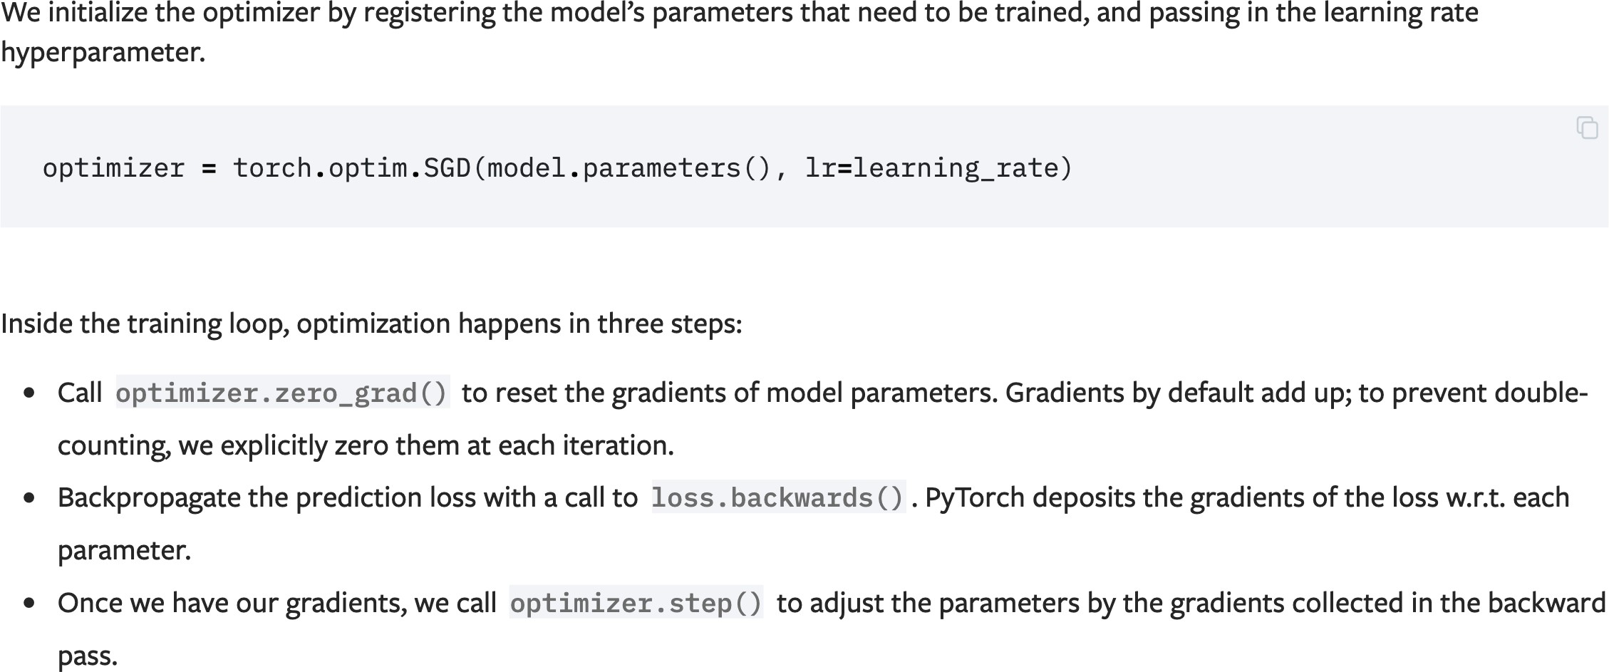
Optimizer
PyTorch
53

Slide 60
Visualisation

Slide 61
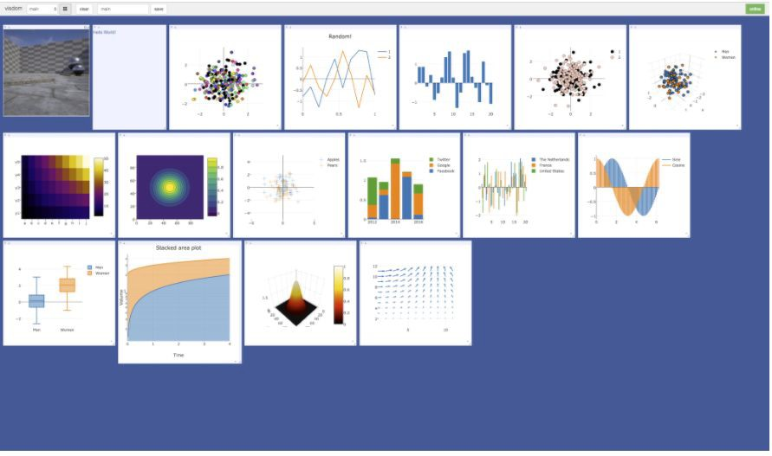
PyTorch
Visualisation
Visdom
54
https://github.com/facebookresearch/visdom

Slide 62
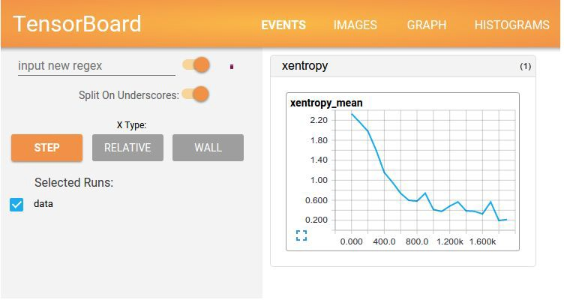
PyTorch
Visualisation
TensorBoard
55
https://www.tensorflow.org/get_started/summaries_and_tensorboard

Slide 63
Save & Load

Slide 64
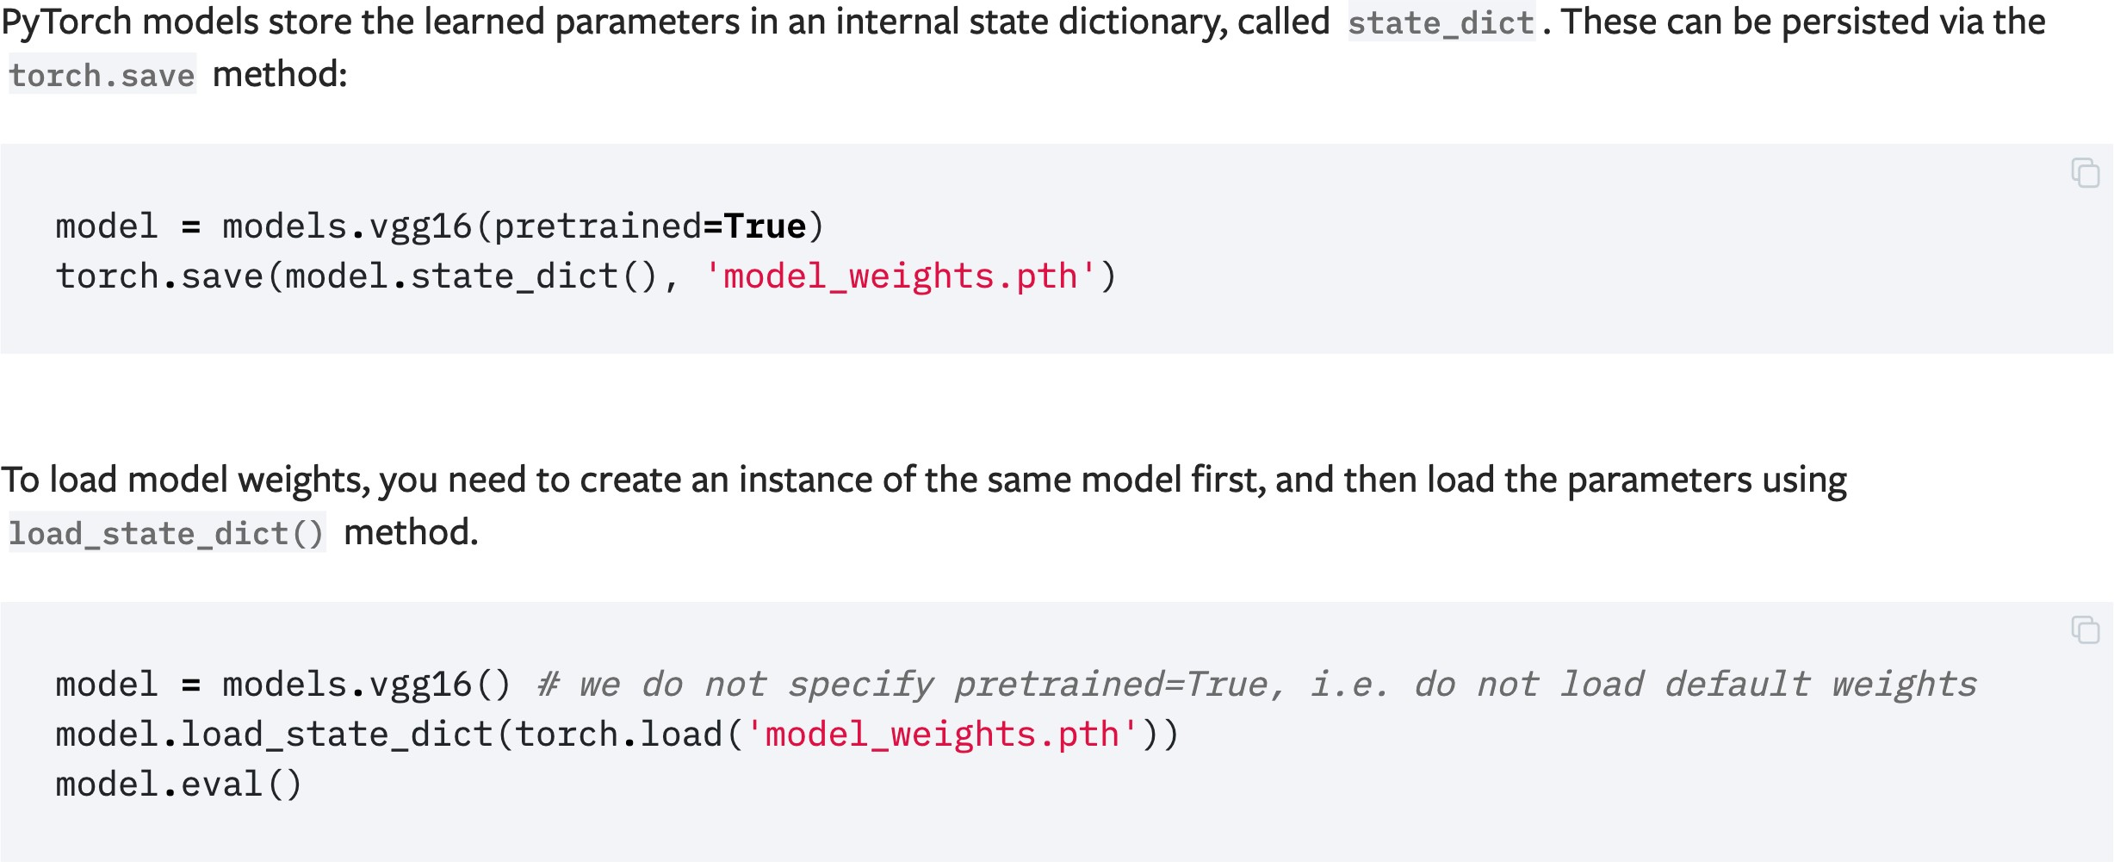
Saving and Loading Model Weights
PyTorch
56

Slide 65

Saving and Loading Models with Shapes
PyTorch
57

Slide 66
Conclusion
PyTorch
PyTorch | Scientific computing package based on python
Tensor | Fundamental datatype or most basic elemt in PyTorch equivalent to numpy.ndarray
FloatTensor | Float Tensor datatype
Autograd | Automatic differentiation of arbitrary scalar valued functions
Variable | Wrapper around Tensor that contains three attributes of data, grad and grad_fn
Compuational Graph | Type of graph that can be used to represent mathematical expressions
Torch.nn | PyTorch Class to help you create and train neural network
Torch.nn.functional | PyTorch Class to. Create and train net that uses functions
GPU | Graphiucal interface to accelerate multiple computations simultanmously
GRU | Gating mechanism in RNN
Dataloader | Iterable that combines a dataset and a sampler over the given dataset
Batch size | Number of training examples one forward/backward pass
Iterations | Number of passes
Epoch | Method of evaluating how well aan algorithm is modeling the dataset
Loss Function | Method of evaluating how well the algorithm is modeling the dataset
Optimizer | Minimizer of the loss function
Visdom | Visualisation tool that generates rich visualizations of live data
TensorBoard | Visualisation tool for machine learning experimentation
58

Slide 67
Resources
PyTorch
Official resources
Documentation http://pytorch.org/docs/master/
Tutorials http://pytorch.org/tutorials/index.html
Example projects https://github.com/pytorch/examples
Github code
fairseq-py
OpenNMT-py
Open course & tutorial used in this presentation
Stanford CS231N 2017, Lecture 8 “Deep Learning Software”
https://pytorch.org/tutorials/beginner/basics/intro.html

